Slide 1
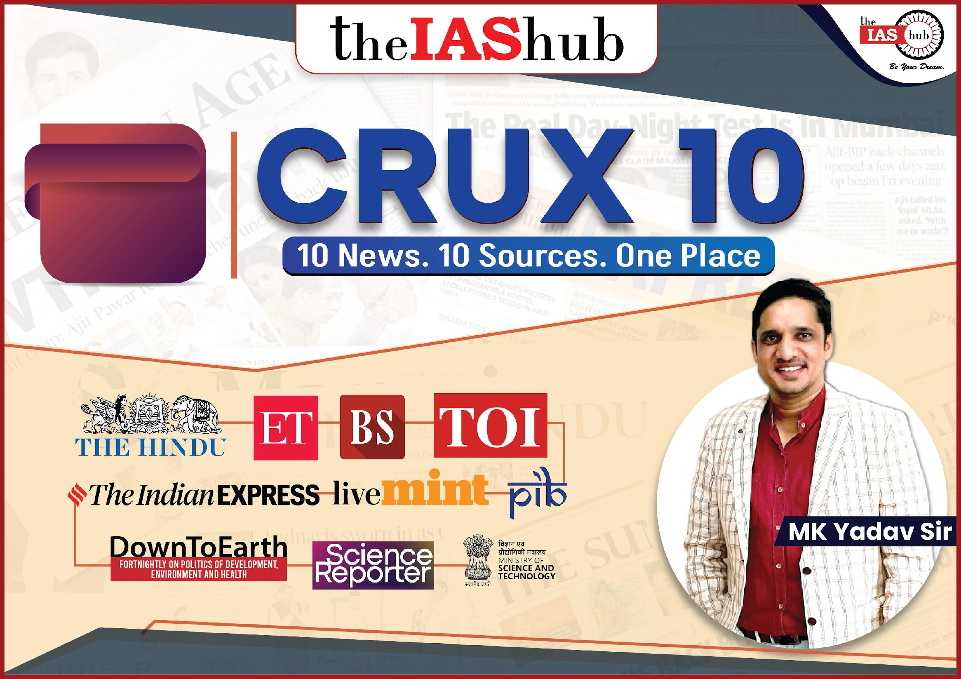
SEPTEMBER
14

Slide 2

OPEC+
Eastern Maritime Corridor (EMC)
Morocco
Carbon Dioxide Emission
CWMA
Libya
Kisan Credit Card
African Swine Fever
SCO & QUAD
CEC & Other ECs Bill 2023

Slide 3




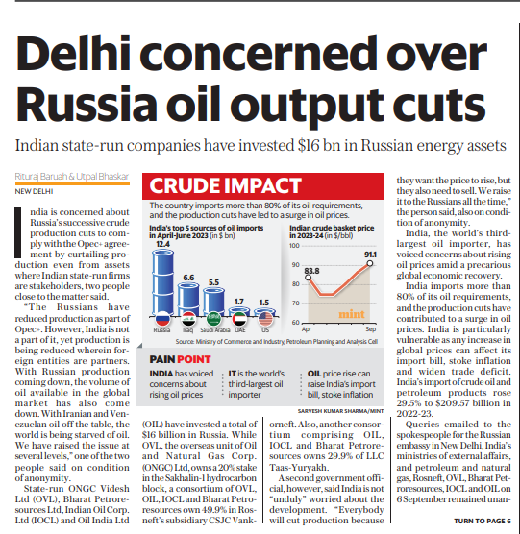
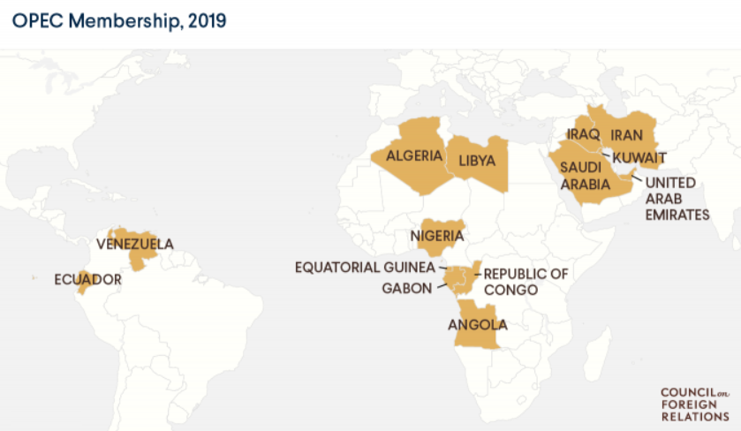
LIVEMINT
OPEC+
(Syllabus: GS Paper 2 – IR)
Page 3
Context: Recently, India has expressed concerns over Russia's consistent reduction in crude production, even affecting assets involving Indian state-run firms, as part of its efforts to comply with the OPEC+ agreement.
The Russians have decreased production in alignment with OPEC+, but it's important to note that India is not a participant in this agreement.
India, which imports over 80% of its oil needs, has experienced a rise in oil prices due to production cuts, making it susceptible to potential impacts on its import bill, inflation, and trade deficit with any global price increases.
OPEC
About: It is a permanent, intergovernmental organization of 13 countries, created at the Baghdad Conference in 1960, by Iran, Iraq, Kuwait, Saudi Arabia, and Venezuela.
Headquarter: Vienna, Austria.
Aim: To regulate oil supply with the aim of stabilizing the global oil price, thus preventing volatility that could negatively impact the economies of both oil-producing and oil-importing nations.
OPEC+
About: It is a group of 23 oil-exporting countries which meets regularly to decide how much crude oil to sell on the world market.
Aim: To work together on adjusting crude oil production to bring stability to the oil market.
At the core of this group are the 13 members of OPEC (the Organization of the Oil Exporting Countries), which are mainly Middle Eastern and African countries.
Members: 13 members of OPEC (Saudi Arabia, the UAE, Iran, Iraq, Kuwait, Algeria, Angola, Equatorial Guinea, Gabon, Libya, Nigeria, the Republic of the Congo, and Venezuela) and 10 other oil-producing countries (Russia, Azerbaijan, Bahrain, Brunei, Kazakhstan, Malaysia, Mexico, Oman, South Sudan and Sudan).
Russia, a major oil producer surpassing even Saudi Arabia, holds a pivotal position alongside OPEC in shaping worldwide crude oil price trends.

Slide 4

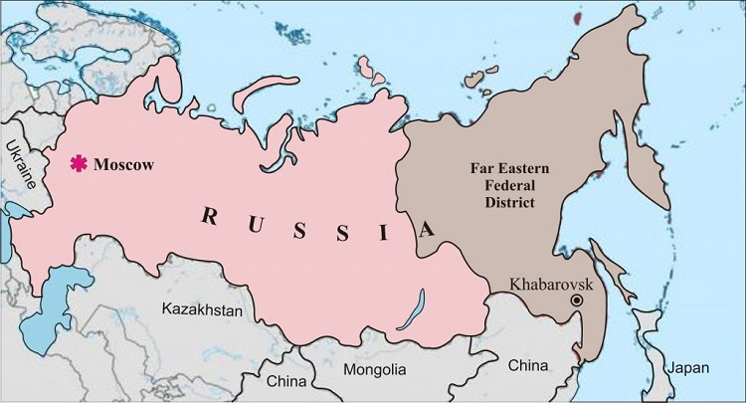
EASTERN MARITIME CORRIDOR (EMC)
(Syllabus: GS Paper 2 – IR)
PIB
Sept 14
Context: Indian shipping Minister recently said India and Russia seek to begin operations on the Eastern Maritime Corridor (EMC).
Eastern Maritime Corridor (EMC)
About: It is a proposed sea route between the Indian port of Chennai and the Russian port of Vladivostok.
The corridor is anticipated to reduce the transportation time between Indian and Russian ports in the Far East Region by approximately 40%, decreasing it from the current 40 days to 24 days.
Current Trade Route: Currently, the trade route connecting Mumbai, India, and St. Petersburg, Russia, spans a distance of 8,675 nautical miles.
Distance Cover: 5,600 nautical miles, which is significantly shorter than the current route via the Suez Canal.
Reduced Transport Time: It will significantly decrease the transportation duration for goods traveling from India to Far East Russia, reducing it to 24 days from the current over 40 days.
Benefits like enhanced Market Access: India will gain improved and more efficient access to the markets of the Far East, including countries like China and Japan, through the EMC, creating shorter trade routes.
Vladivostok
Situated in: Russia's Far East
Geographic Location: Positioned on the shores of Golden Horn Bay, it is situated to the north of North Korea and in close proximity to Russia's border with China.
Prominent Port: Vladivostok serves as the largest port along Russia's Pacific coast and serves as the home base for the Pacific Fleet of the Russian Navy.

Slide 5


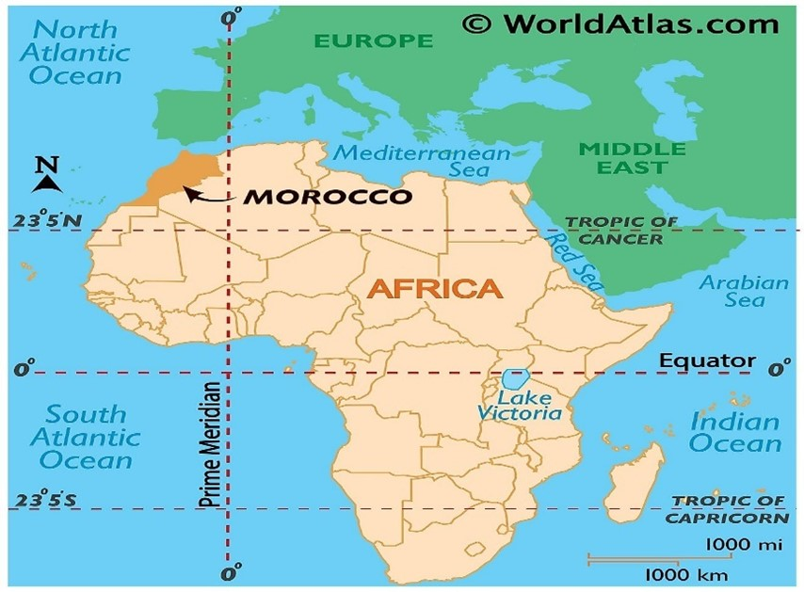
TOI
MOROCCO
(Syllabus: GS Paper 1 – Geography)
Sept 14
Context: The Moroccan media reported damage in many parts of Morocco including the city of Marrakesh due to the recent Earthquake.
Morocco
Location: Western North Africa.
Boundary: Algeria to the east and southeast, Western Sahara to the south, the Atlantic Ocean to the west, and the Mediterranean Sea to the north.
  It is the only African country with coastal exposure to both the Atlantic Ocean and the Mediterranean Sea.
Strait: It lies directly across the Strait of Gibraltar from Spain.
Climate: Mediterranean climate, with mild wet winters and hot dry summers.
Mountain Ranges: The Atlas Mountains dominate the central part of the country, while the Rif Mountains make up the northern edge.
  Jebel Toubkal is the highest point in Morocco at 13,664 ft (4,165 m) and is also the highest peak of the Atlas Mountains.
Earthquake
An earthquake refers to a strong trembling of the Earth's surface.
Causes of earthquake: Tectonic plate movement and faults within earth crust, volcanism, man-made seismicity like- nuclear explosion, landslide and glacier meting etc.
Earth's Composition: The Earth consists of four fundamental layers: a solid crust, a hot and mostly solid mantle, a liquid outer core, and a solid inner core.
Lithosphere Formation: The solid crust and the upper, rigid portion of the mantle together constitute a zone known as the lithosphere.
Tectonic Plate Structure: The lithosphere comprises tectonic plates, which are in constant motion as they drift atop the slowly flowing mantle layer beneath

Slide 6
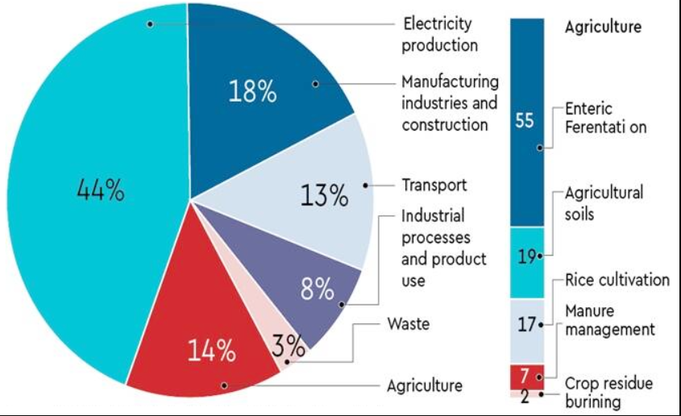
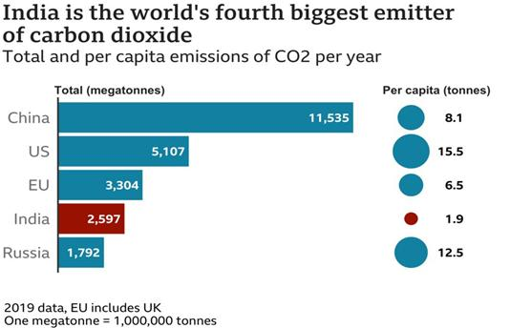
DTE
CARBON DIOXIDE EMISSION
(Syllabus: GS Paper 3 – Env & Eco)
Sept 14
Context: According to new analysis by research organisation Oil Change International. Just 20 countries in the world, led by the United States, would be responsible for nearly 90 per cent of the carbon dioxide emissions through 2050.
Key Points of Report
Five countries in the global north — the United States, Canada, Australia, Norway and the United Kingdom — would contribute the majority of emissions through 2050.
These countries with the greatest economic means to rapidly phase out oil and gas production would contribute to 51 per cent of the planned oil and gas explorations.
Five countries, the nations in the top 20 ‘planet wreckers’ include Russia, China, Iran, Brazil, UAE, Iraq, Turkmenistan, Saudi Arabia, Guyana, Qatar, Argentina, Mexico, Nigeria, India and Kazakhstan.
According to the report: If the 20 countries allow this scale of new oil and gas extraction, it could become impossible to hold global temperature rise to the 1.5° Celsius limit.
UAE is also set to be one of the largest oil and gas production expanders despite pledging to use its COP28 presidency to “keep 1.5°C alive.
Carbon Dioxide Emission
About: CO2 is a greenhouse gas that is released into the atmosphere when fossil fuels are burned, such as coal, oil, and natural gas.
CO2 emissions are the primary cause of climate change.
Sources of CO2 emissions: Electricity generation, Transportation, Industry, Agriculture, Forestry etc.
CO2 emissions can be reduced by: Using renewable energy sources, Improving energy efficiency, Switching to electric vehicles, Reducing deforestation, Planting trees, carbon capture and storage.

Slide 7
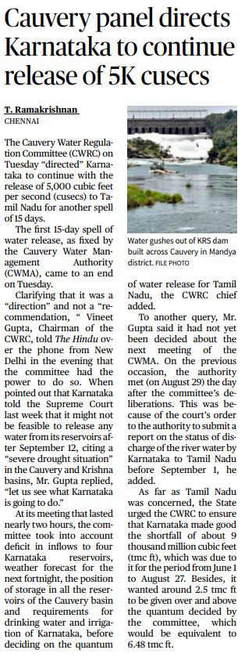
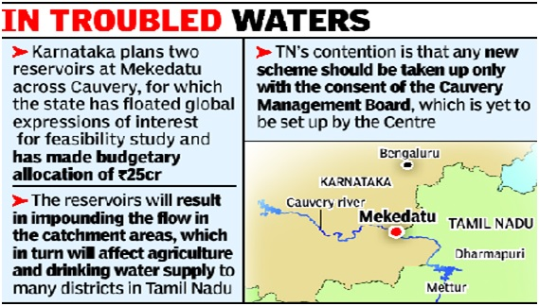
CWMA
(Syllabus: GS Paper 2 – Polity)
THE HINDU
Page 4
Context: Recently, the Cauvery Water Regulation Committee "instructed" Karnataka to extend the release of 5,000 cubic feet per second (cusecs) of water to Tamil Nadu for an additional 15 days.
Cauvery Water Management Authority (CWMA)
It has been created as per the Cauvery Management Scheme earlier framed by Centre and approved by Supreme Court.
Formation: In 2018 by instructions of the Supreme Court
Composition: Chairman, a secretary and eight members.
  Out of the eight members, two will be full time, while two will be part time members from centre’s side.
  Rest four will be part time members from states.
Functions: To ensure the enforcement and adherence to the directives of the Supreme Court concerning the "storage, allocation, management, and oversight of Cauvery waters."
It will also offer guidance to the states on implementing measures to enhance the efficiency of water utilization.
Cauvery
About: It is the largest river in the Karnatka state.
Known as: Dakshina Ganga (the Ganges of the South) and considered one of the sacred rivers of India.
Origin: Bramahagiri Hills near Madikeri in Coorg.
Tributaries: Harangi, Hemavathi, Lakshmanatirtha, Kabini, Shimsha, Arkavati, Suvarnavathi or Honnuholé, Bhavani, Lokapavani, Noyyal, Amaravati.

Slide 8

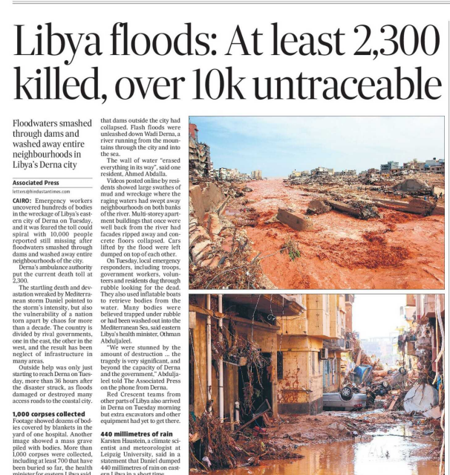
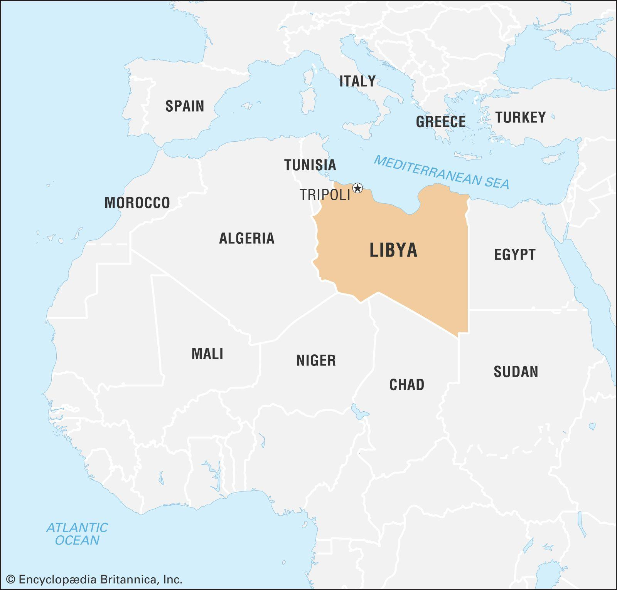
HINDUSTAN TIMES
LIBYA
(Syllabus: GS Paper 1– Geography)
Page 9
Context: Devastating floods occurred in Derna, Libya due to the collision of Dams and flash floods caused by a Mediterranean storm named Daniel.
Libya
Libya, a predominantly desert nation with significant oil reserves, gained independence in 1951.
Capital: Tripoli
Geography and Population: Libya, situated in North Africa, primarily consists of the vast Sahara desert.
  The majority of its population resides along the coastal areas, where key cities like Tripoli and Benghazi are located.
Boundaries: It is a country in the Maghreb region in North Africa
North: Bordered by the Mediterranean Sea.
East: Shares a border with Egypt.
South: Shares boundaries with Niger and Chad.
West: Bordered by Tunisia and Algeria.
Derna
Derna (Darnah) is a port city in eastern Libya.
The city is bisected by the Wadi Derna, a seasonal river that flows from highlands to the south, and normally protected from flooding by dams.
The city was once a hub for extremist groups in the years of chaos that followed the NATO.

Slide 9
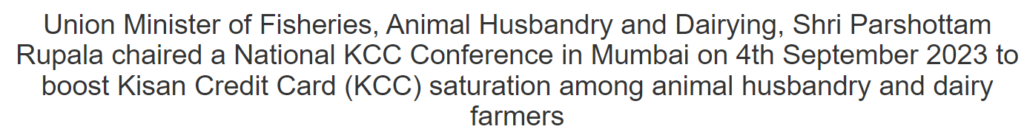
PIB
KISAN CREDIT CARD
(Syllabus: GS Paper 2 – Government Schemes)
Sept 14
Context: The Union Minister of Fisheries, Animal Husbandry and Dairying, chaired a National KCC Conference recently, to boost Kisan Credit Card (KCC) saturation among animal husbandry and dairy farmers.
Kisan Credit Card (KCC)
Nodal Ministry: Ministry of Fisheries, Animal Husbandry and Dairying.
Origin: It was introduced in 1998 based on a model scheme prepared by the National Bank for Agriculture and Rural Development (NABARD).
Implementing Agencies: Commercial Banks, Regional Rural Banks (RRBs), Small Finance Banks & Cooperatives
Objectives: To meet the short-term credit requirement for cultivation.
To manage post-harvest expenses.
To meet the consumption requirement of the farmer’s household.
Key Features
KCC offers several benefits, including an ATM-enabled RuPay Card, simplified documentation, automatic limit escalation, and unrestricted withdrawals within the set limit.
Expansion of Eligibility: In 2004, the eligibility criteria for the program were broadened to encompass farmers' requirements for investment credit, covering both agricultural and non-farm activities.
Diverse Financial Support: KCC caters to various financial needs of farmers, such as post-harvest expenses, loans for selling produce, and meeting household consumption requirements.
Flexible Repayment Schedule: The repayment period under KCC is determined based on the crop's harvesting and marketing duration, offering flexibility to farmers.
Loan Duration: KCC provides short-term agriculture loans with a maximum tenure of 1 year and long-term loans with a duration of up to 5 years.

Slide 10
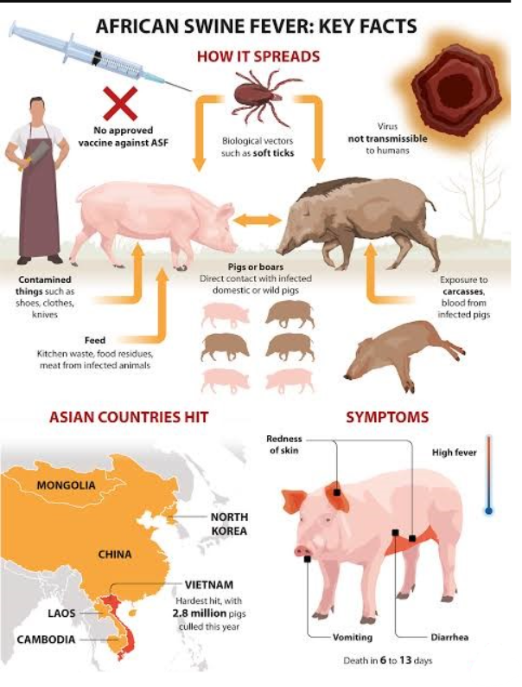
DTE
AFRICAN SWINE FEVER
(Syllabus: GS Paper 3 – Sci & Tech)
Sept 14
Context: Recently, the African swine fever reached the Far North.
African Swine Fever (ASF)
Initial Detection: ASF was first identified in Africa during the 1920s.
Highly Contagious and Lethal: This disease is extremely contagious and almost always fatal for infected animals.
Target Species: ASF affects both domestic and wild pigs, typically leading to an acute form of hemorrhagic fever.
High Mortality Rate: The mortality rate approaches 100%, and since there is no cure for the fever, the primary containment method is culling infected animals.
No Threat to Humans: ASF is not transmissible to humans; it exclusively spreads among animals.
Historical Distribution: Historically, outbreaks have been documented in Africa and regions of Europe, South America, and the Caribbean.
Recent Global Spread: Since 2007, ASF has been reported in numerous countries across Africa, Asia, and Europe, affecting both domestic and wild pig populations.
OIE Listing: ASF is listed as a disease in the World Organisation for Animal Health (OIE) Terrestrial Animal Health Code, mandating its reporting to the OIE.
Lack of Vaccine: Currently, there is no effective vaccine available to combat ASF.

Slide 11

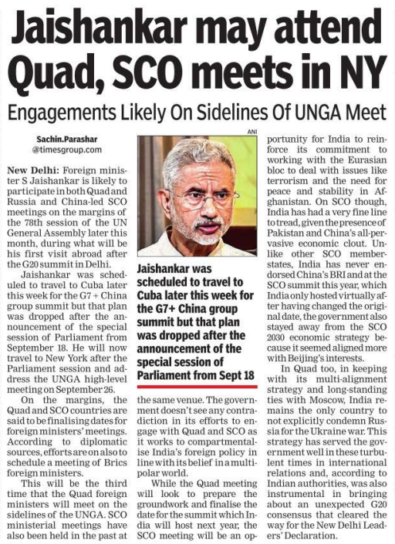
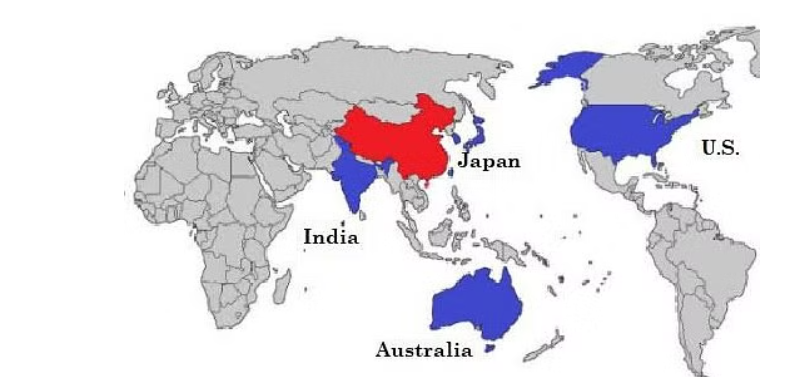
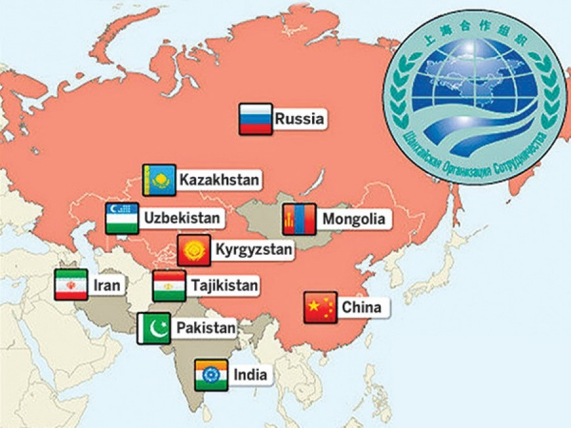
SCO & QUAD
(Syllabus: GS Paper 2 – IR)
TIMES OF INDIA
Page 10
Context: The Foreign Minister of India is expected to take part in both Quad and Russia and China-led SCO meetings on the sidelines of the 78th session of the UN General Assembly later this month, marking his first overseas visit following the G20 summit in Delhi that recently took place.
Quadrilateral Security Dialogue (QUAD)
About: It is also known as the Quadrilateral Security Dialogue or simply the Quad, is a strategic forum.
Countries: United States, Japan, India, and Australia.
Aim: To promote regional security and economic cooperation in the Indo-Pacific region.
Origin of QUAD Concept: It was initially proposed by Japanese Prime Minister Shinzo Abe in 2007. Nevertheless, the initiative faced obstacles as Australia withdrew from it, seemingly influenced by Chinese pressure, which hindered its progress.
Shanghai Cooperation Organisation (SCO)
About: It is a permanent intergovernmental international organisation of Eurasian Nations with a secretariat in Beijing.
Formation: 15 June 2001 by the leaders of China, Kazakhstan, Kyrgyzstan, Russia, Tajikistan and Uzbekistan.
Members: China, India, Kazakhstan, Kyrgyzstan, Russia, Pakistan, Tajikistan and Uzbekistan.
Headquarter: Shanghai (China)
Aim: It is a political, economic and military organisation that aims at maintaining peace, security and stability in the region.

Slide 12
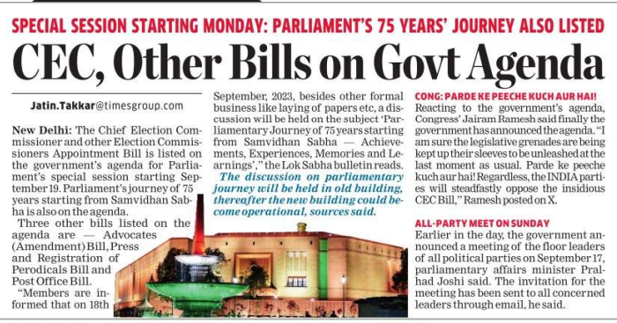

CEC & OTHER ECs BILL 2023
(Syllabus: GS Paper 2 – Polity)
ECONOMIC TIMES
Page 2
Context: The Chief Election Commissioner and Other Election Commissioners' Appointment Bill is scheduled to be presented on the government's agenda during the special session of Parliament.
The CEC and Other ECs (Appointment, Conditions of Service and Term of Office) Bill, 2023
Background: In March of this year, the Supreme Court issued a ruling stating that a committee, consisting of the Prime Minister, Leader of the Opposition in the Lok Sabha, and the Chief Justice of India, should be responsible for appointing the CEC and ECs.
To overcome this ruling of the SC, the government is bringing this Bill.
Major features of the New Bill
Committee Composition: Prime Minister, the Leader of the Opposition in the Lok Sabha, and a Cabinet Minister nominated by the Prime Minister.
Qualifications for Appointment: They should have held or currently hold a post equivalent to the rank of secretary.
Appointments Process: The Selection Committee, consisting of the Prime Minister, the Leader of the Opposition in the Lok Sabha, and the nominated Cabinet Minister, will appoint the CEC and ECs from the prepared panel.
Search Committee: It will consist of two other members not below the rank of Secretary to the government, knowledgeable in matters related to elections.
Election Commission India
About: It is an autonomous constitutional body responsible for administering Union and State election processes in India.
Establishment: 25th January 1950.
Appointment: Under Article 324 (2), the President appoints the CEC and other
Tenure: 6 years or until they reach the age of 65 years, whichever is earlier
Removal: Similar to that of a Supreme Court judge
Aim: To define and control the process for elections conducted at various levels: Parliament, State Legislatures, and the offices of the President and Vice President of India

Slide 13
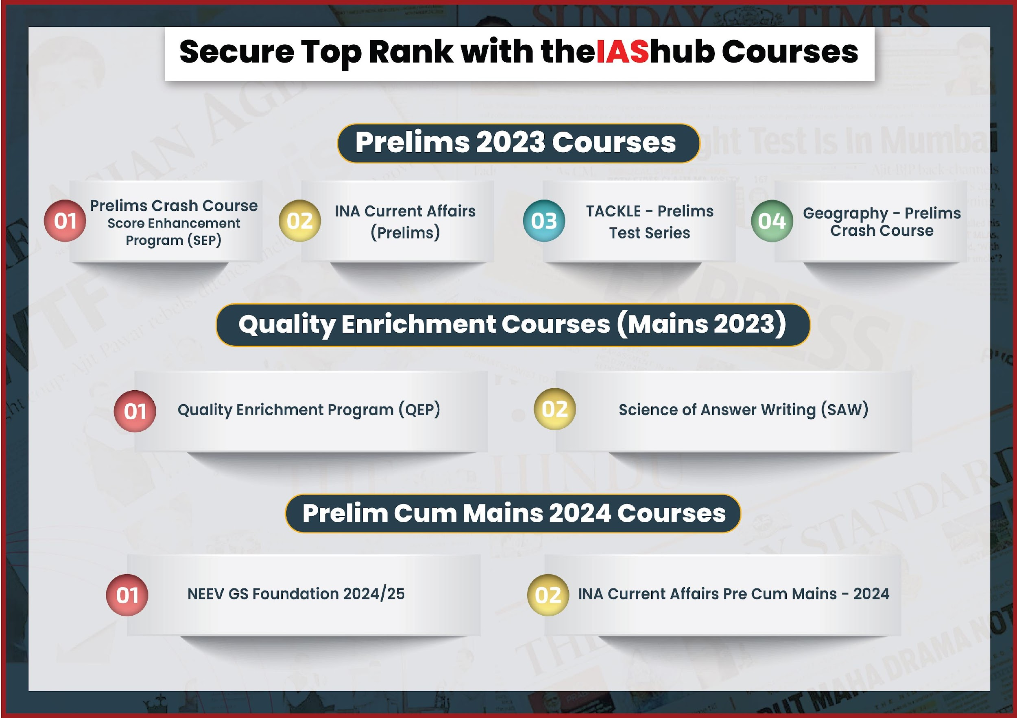

Slide 14


